Slide 1
Relation between Layoff and Corning Inc. performance
Anju Mishra
Colorado state university global
MIS581 :Capstone - Business Intelligence and Data Analytics
Dr. Jamia Mills
10th Jan 2025

Slide 2
Problem statement:
Corning Incorporated, a global leader in materials science, faces significant operational challenges due to the interconnected nature of its five business segments: Display Technologies, Optical Communications, Environmental Technologies, Specialty Materials, and Life Sciences. Periodic dips in the sales volume of the Optical Communications segment, particularly in optical fiber, often result in production slowdowns and workforce layoffs. However, these disruptions are not confined to this segment alone, as Corning operates as a unified organization where corporate-level decisions are influenced by the combined performance of all segments.
This interconnected structure complicates the ability to predict and respond to market fluctuations effectively, as workforce disruptions and operational challenges are driven by both segment-specific trends and broader market forces. The lack of a comprehensive approach to addressing these challenges highlights the need for holistic strategies that stabilize operations across all business sectors, minimize workforce disruptions, and enhance the company's long-term growth and resilience.

Slide 3
Hypothesis for problem statement:
First hypothesis:
Null Hypothesis (H₁0): The optical fiber market exhibits a cyclical growth pattern, characterized by periods of expansion lasting two to three years, followed by dips in demand or sales. These dips persist for a year or two before the market resumes growth.
Alternative Hypothesis (H₁1):The optical fiber market growth is steady over time, showing consistent upward trends without significant cyclical dips. Growth is driven by ongoing global adoption of fiber technologies, sustained investments in infrastructure like 5G and FTTH (Fiber to the Home).
Second hypothesis:
Null Hypothesis (H₂0):The optical fiber market’s periodic growth and unpredictable dips lead to significant financial challenges for manufacturers like Corning. These challenges, including revenue shortfalls and reduced profitability, directly contribute to operational cost-cutting measures such as massive layoffs.
Alternative Hypothesis (H₂1):The optical fiber market’s growth or loss is irrelevant to massive layoffs at Corning Incorporated. Layoffs are driven by other factors, such as internal strategic decisions, technological shifts, operational restructuring, or competitive pressures, rather than directly correlating with sales trends or market performance.

Slide 4
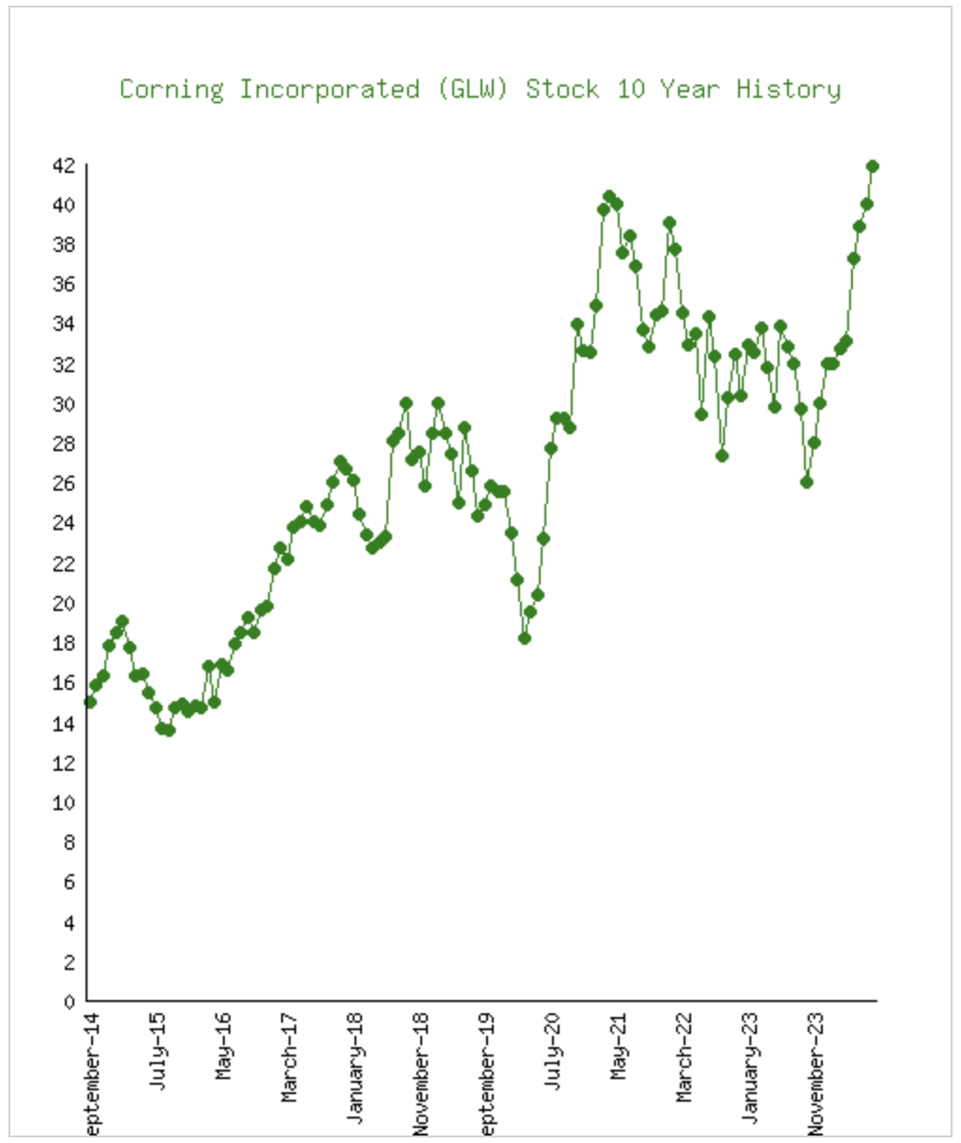
GLW 10-Year Price Performance Graph:
Displayed here is a visual depiction presenting the closing prices of Corning Incorporated (GLW) spanning the last decade. This graph employs adjusted closing prices instead of market closing prices. (The adjusted close considers significant corporate or institutional-level actions that occur beyond regular market hours.)
As of December 31, 2020, there were approximately 12,090 registered holders of common stock and approximately 515,000 beneficial shareholders.
Figure 1:Corning stock market performance from 2014 to 2023

Slide 5
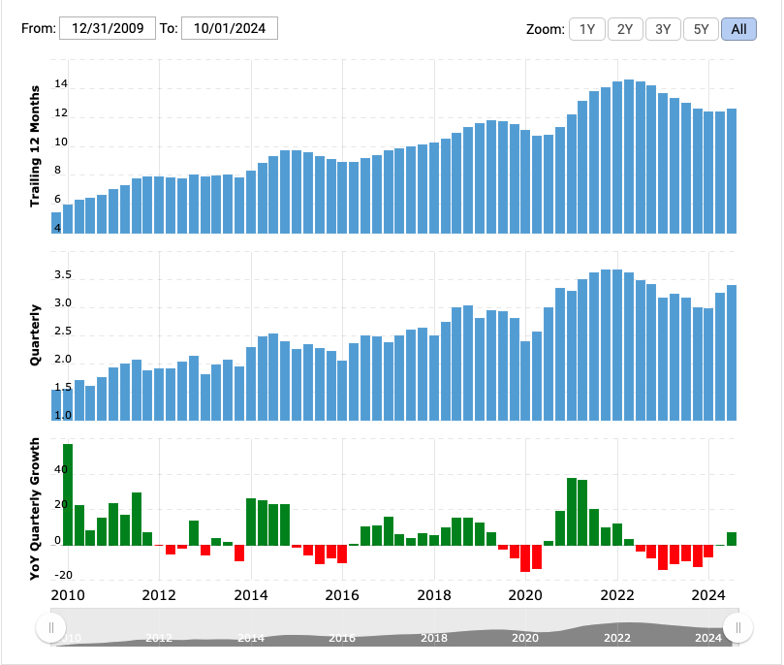
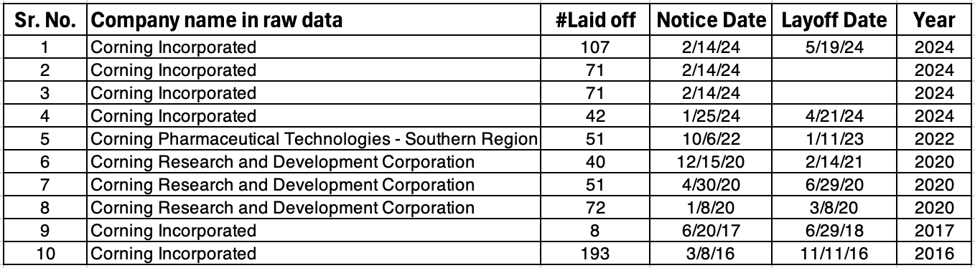
Revenue and Stock market trend for Corning Inc.:
Corning annual/quarterly revenue history and growth rate from 2010 to 2024. Revenue can be defined as the amount of money a company receives from its customers in exchange for the sales of goods or services.
Layoff data for the years when Corning had loss in revenue and stock market:
Corning Incorporated filed 10 WARN layoff notices from Mar 2016 to May 2024.706 employees were laid off in total from these layoffs.
Notes:
Continuous manufacturing (CM) is gaining popularity in the pharmaceutical industry because it represents an improved approach for small molecule drug product development compared to traditional batch manufacturing methods. Merck follow the guideline of CM and use PM and NLP for process improvement. Made this an innovation story with the help of data analysis and tools.

Slide 6
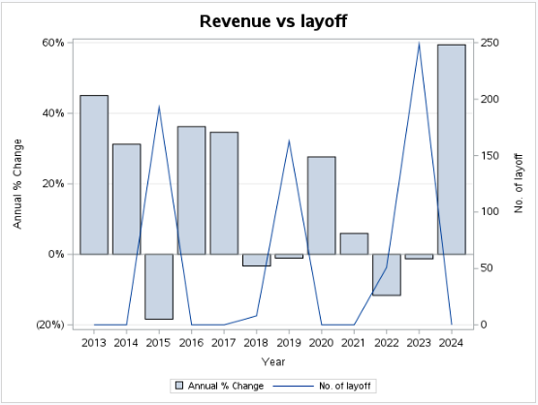
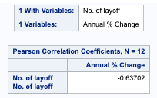
Data analysis outcome:
Correlation Analysis:
The Correlation analysis performed for yearly revenue changes vs layoff in last few years and the correlation shows -0.63 which shows good correlation.
Showing correlation with the bar and line chart:
Figure 7: Pearson correlation factor
Figure 8: Bar chart showing revenue vs layoff
Notes:
Advanced Analytics for Process Optimization:
Enhance process understanding, identify potential trends or shifts, and segregate materials to prevent lot impact.
Understanding normal operations allows for early detection of shifts/trends before warnings are triggered.

Slide 7
Key take away from the Data analysis:
Findings result in accepting or rejecting the hypothesis:
As per the result the second null hypothesis has been failed to reject. I have mentioned the second null hypothesis in this section, which is mentioned in previous section just to recap and emphasize the point.
First hypothesis, optical fiber market exhibits a cyclical growth pattern which is not evident from the data.
First hypothesis also mentioned, pattern indicates that the market is inherently volatile, which is not evident from data too.
From second hypothesis, it mentions Corning faces unpredictable dips lead to significant financial challenges which is getting supported by data as 2020 Covid was unpredictable.
Second hypothesis also mention about the financial dip and workforce layoff is related to each other and data is supporting that.
Notes:
Operational Considerations:
Transition to Volumetric Mode: During hopper refills, the feeder temporarily operates in volumetric mode, maintaining a constant screw speed.
Optimization Parameters: Critical factors like minimum refill level and refill amount are optimized to ensure a stable feed rate.
Stable Operating Region: The green box in Figure 1 highlights the stable operating region where feed factor and net weight are consistent.

Slide 8
Conclusion:
This study delves into the challenges faced by Corning Incorporated due to periodic dips in sales within the Optical Communications segment, particularly in the optical fiber market.
Sales Trends and Market Dynamics: Corning's sales figures in the optical fiber market show periodic dips, which appear to be aligned with broader market cycles influenced by economic conditions, infrastructure investment patterns, and technological advancements such as 5G rollouts.
Layoff Patterns and Strategic Implications: Layoffs at Corning often correlate with declines or stagnations in optical fiber sales but are also influenced by broader corporate strategies, such as operational restructuring and competitive pressures.
The findings till now suggest that Corning’s layoff decisions are influenced not only by short-term sales trends but also by broader strategic adjustments and market forces.
Github: https://github.com/anjumishra16/MIS581

Slide 9
Reference:
Allied Market Research. (n.d.). Optical fiber market. Retrieved from https://www.alliedmarketresearch.com/optical-fiber-market
Corning Incorporated. (2020). Form 10-K Annual Report. Retrieved from https://s203.q4cdn.com/212458750/files/doc_financials/2020/q4/10k20.pdf
InformationWeek. (n.d.). Corning to cut 1,000 jobs, close plant. Retrieved from https://www.informationweek.com/it-leadership/corning-to-cut-1-000-jobs-close-plant
Markets and Markets. (n.d.). Search results for "optical fiber." Retrieved from https://www.marketsandmarkets.com/search.asp?search=optical+fiber
Maximize Market Research. (n.d.). Global fiber optic cable materials market. Retrieved from https://www.maximizemarketresearch.com/market-report/global-fiber-optic-cable-materials-market/106666/
Netcials. (n.d.). Stock 10-year history (NYSE: GLW) Corning Incorporated. Retrieved from https://www.netcials.com/stock-10-year-history-nyse/GLW-Corning-Incorporated/
Star-Gazette. (2020, May 13). Corning Inc. to lay off hundreds of workers at two local plants. Retrieved from https://www.stargazette.com/story/news/local/2020/05/13/corning-inc-lay-off-hundreds-workers-two-local-plants/5183974002/
The Biz Voice. (n.d.). Corning layoffs. Retrieved December 8, 2024, from https://thebizvoice.com/corning-layoffs/
WARN Tracker. (n.d.). Corning Incorporated. Retrieved December 8, 2024, from https://www.warntracker.com/company/corning-incorporated

